Slide 1
ICT Info session 22 / 03 / 2024
This meeting is recorded for purposes of meeting minutes, delayed viewing by absentees, and internal (HD) operations. The recording will be stored internally, accessible by Sciensano employees, and temporarily by invitees.

Slide 2
CONTENTS
Announcements
Open Questions & Answers
Topics for Discussion
VPN Solution
Round Table
Next Time

Slide 3
ANNOUNCEMENTS
WHAT
WHY
WHEN
NA
NA
NA
NA
NA
NA
1
NA
NA
NA
NA
NA
NA
2

Slide 4
OPEN QUESTIONS & ANSWERS
NAME | QUESTION | ANSWER
Bart De Maeyer | Queries & uncertainty around XML files and NIC flow | Jason suggested a 30 min call to align. Was this done?
Pieter Van Honacker | Can issue RITM0014638 be looked at? On one of the previous online meetings, I already mentioned this problem and the answer was that this was going to be looked at. There has been told that it was an issue with the portal itself, not showing all the reports.
Dirk De Beule | INC0213784 - Where can I see which flow has been set for our hospital when it comes to the MyCarenet flow to the NIC. We now assume that the automatic flow is set. So not the standard option, but the option directly to the NIC. Can you provide clarity about this? | Can you elaborate on this please? The question is somewhat ambiguous

Slide 5
OPEN QUESTIONS & ANSWERS
NAME | QUESTION | ANSWER
Erik Vanden Meersch | We are submitting registrations to the BCFR register. This needs to be done yearly, for all patients of the muco center. We are currently trying to send the data collected in 2022. People of the center tell me that in hd4dp there see two versions of the register: v9 and V10 We use the v9 DCD and submit to v9. We get as reply that NR_YR_COLCN (the year of the data collection) of 2022 is not accepted. I resend with the value 2023 and that is successful (but not correct) However, that submission appears on the web site under v10 !! Conclusion: we don’t know what to do with the data collected in 2022 Use DCD version v9 or v10? For NR_YR_COLCN use the value 2022 or 2023 ? Send to https://hd4dp.uz.kuleuven.ac.be/proxy/api/dcd/payload/submit?organization-id=22&dcd-id=54&version=9 or 10&data-src-type=API Look for the submissions in the web interface under V9 or V10 Could we have a call or explanation otherwise for the phenomena that we see ? | We will set up a dedicated session with you to clear this matter.

Slide 6
STANDARDISE VPN PRoposal

Slide 7
VPN SOLUTION
Challenge:
Supporting multiple VPN solutions is causing a lot of operational and administrative overhead along with impacting time to resolution of the tickets –
AS IS:
Supporting 16+ VPN solutions (TeamViewer, Bomgar, Fortinet, Cisco, BigIP Edge, etc.)
No standardised approach for connecting to all DP
Impact:
Average time to connect to DP (30m to 2h+) Tickets are not being resolved on time
Increase of administrative backlog and operational overhead for technical teams
Security risk due to lack of password rotation at DP etc.
TO BE:
1 VPN solution for all – standardised approach
Isolated robust secure solution with logging (Better security, Access Mgmt. Time Saving)

Slide 8
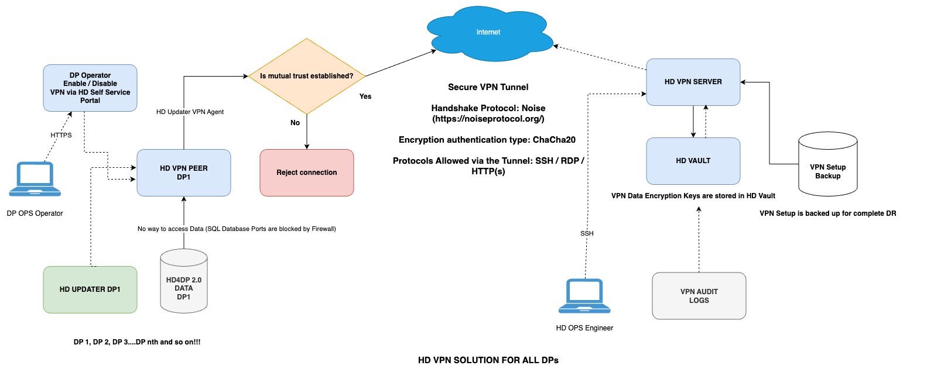
LOGICAL DESIGN

Slide 9
SOLUTION BENEFITS
DP have full control Enable and Disable Agent
A Secure VPN Tunnel
Separate Network (VLAN)
DP to DP access is blocked by Firewall
Firewall to block all data transfer except HD4DP 1.0 and 2.0 (Allowed only SSH, HTTP(s) and SFTP ports)
Full Audit Logs and monitoring is going to be available showing who enable disable VPN
Who is logging into SSH/RDP from HD Ops Engineer?
VPN HealthCheck Status page can be provided for HD/DP OPS Team
Less maintenance of whitelisting of URLs in the firewalls at DP sides would be required

Slide 10
ROUND TABLE APPROACH
Collaborative sessions around your questions & queries
We want to build the ICT info sessions around your topics!
What topics would you like to see in the ICT info session?

Slide 11
BI-WEEKLY ICT MEETING

Slide 12
APPENDIX

