Slide 1
ICT Info session 12 / 01 / 2024
This meeting is recorded for purposes of meeting minutes, delayed viewing by absentees, and internal (HD) operations. The recording will be stored internally, accessible by Sciensano employees, and temporarily by invitees.

Slide 2
CONTENTS
Announcements
Open Questions & Answers
EAM 3.0 Tips & Tricks
Round Table

Slide 3
ANNOUNCEMENTS
WHAT
WHY
WHEN
Upgrade of NextGen Nextgen from version 4.0.1 to the latest version 4.4.2.
Security Patching https://github.com/nextgenhealthcare/connect/wiki/Release-Notes
Update Tuesday morning
9th January 2024
1
Technology Roadmap Business, Operations, Security & Compliance, Platform, Application, Data & Storage, Infrastructure
Technical & Business Challenges it helps resolve conflicts around priorities and ensures that alignment strategic objectives.
Q1 2024 January 2024 finalise the technology roadmap – Present to Board for approval
2

Slide 4
ANNOUNCEMENTS
WHAT
WHY
WHEN
System 2 System Training Sessions
Open Questions To support the user communication with integration and using S2S
Update Wednesday 17 Jan
1030h to 1130h
3
EAM 3.0 Training Session
Open Questions To support the user communication with integration and using EAM 3.0
TBC User Community Feedback
4

Slide 5
OPEN QUESTIONS
NAME | QUESTION | ANSWER
Nicolai Vroonen Jan Palfijn Gent | RITM0014681 - The Grants for the users in EAM v3 are not going through in HD4DP. One of our users has 26 Grants to different author groups as Local study group but aren't accessible in HD4DP on the local installation. | Issue outstanding currently being investigated – estimated time to fix 2 weeks
Erik Vander Meersch NexuzHealth | Since today the problem with the Author Groups is back. This problem was gone for a number of weeks but suddenly today, we get this again. As nothing has changed on our side, we have no clue what to do. It blocks our registrations and is very annoying. Can you please give this some attention | Issue outstanding currently being investigated – estimated time to fix 2 weeks A ticket has been created for this issue: INC0213288
Damien Van Wilder UCL St Luc | In June 2023, you explained that you would be moving on to version 2 of several registers. When I visit the websites dedicated to these registers, I notice that a lot of them have not been updated. Can you update this slide in the next ICT information session?” | There have been no migrations performed. A communication will be shared with a new timeline.
Thomas Elskens UZ Brussel | RITM0014459 - About the registration of a followup of a valves intervention: Will this registration trigger a separate submission to NIPPIN? If so, there will be new record for this registration in the NIPPIN db (with a new registration code) ? | A new DCD submission generates a new registration in the NIPPIN DB

Slide 6
OPEN QUESTIONS
NAME | QUESTION | ANSWER
Annelies Dreessen Chipsoft | RITM0014526 - General issues relating to the discrepancies between the example files provided on the website and the actual documentation. Headers being added to example files but not represented in the documentation. | We recognize that every time we perform an update, we also need to update the example files – we are currently looking at automating this process to ensure that all example files are kept up to date.
Thomas Lasat AZ St-Jan | INC0212805 – When we make API calls that don’t require authentification we are successful but when we attempt to make a call to receive a token to perform automatic registrations we repeatedly receive an error. | We understand you require some assistance for System-to-System Integration – There is an API workgroup where we show people how to setup and use it. Would you be interested in joining?
Haithem Ben Salem UCL St Luc | INC0213001 – Invalid Author Group | Issue has been resolved
Sébastien Wautelet UCL St Luc | INC0212923 - We submitted a JSON file through the API. It's an angioplasty with 2 PCIs. When looking at the submitted form in the web app, in the second PCI, the second material from the first segment is missing, as well as the second segment. | Issue has been resolved and on PRD

Slide 7
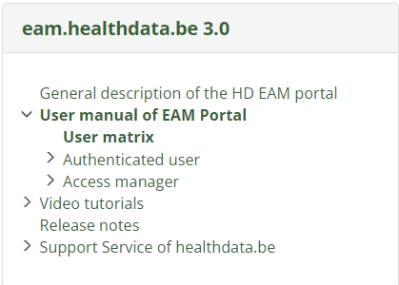
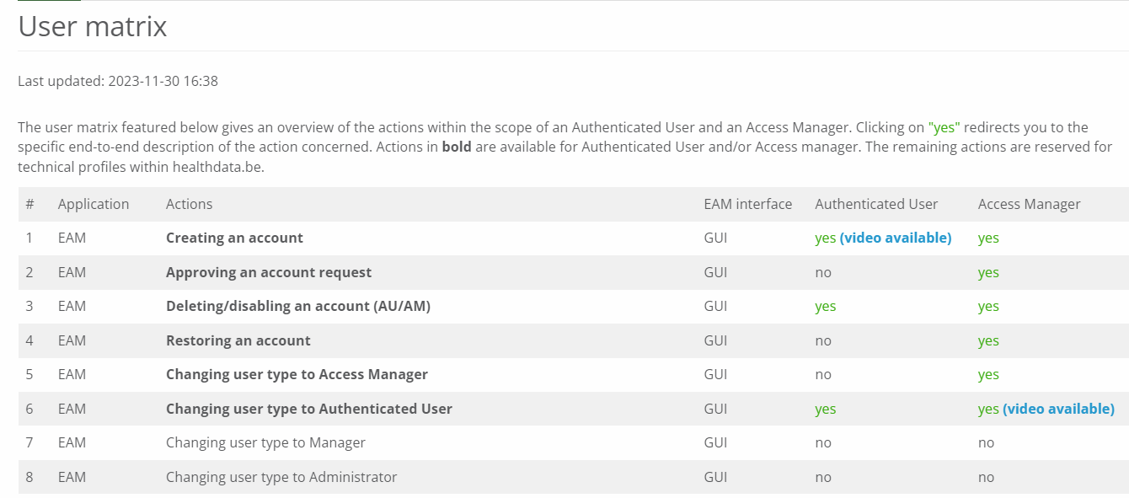
EAM 3.0 TIPS AND TRICKS
Communication sent: 13/12/2023
Description: Updates to Pacemaker
label update for field 'Datum van follow-up' (DT_FLLWUP) into 'Datum van follow-up of datum van laatste contactname met de patiënt‘
Removal of the condition (Only when CD_FLLWUP_PAT_CONT_TPE = 1)
Label update for validation rule TX_ERR_369 (De geboortedatum kan niet liggen na de datum van follow-up of datum van laatste contactname met de patiënt).

Slide 8
ROUND TABLE APPROACH
Collaborative sessions around your questions & queries
We want to build the ICT info sessions around your topics!
What topics would you like to see in the ICT info session?

